Slide 1
Lossless Compression Algorithms
B C Dhara
Department of Information Technology
Jadavpur University

Slide 2
Introduction
Multimedia age
Multimedia → multiple media
  Image/picture/graphics
  Audio
  Video
Storing/transmission
  Huge volume of storage space or high bandwidth network
  We discuss about the compression
B C Dhara, Dept. of IT, JU

Slide 3
Audio is 1D signal
Image/picture/graphics 2D signal
Video is 3D signal
B C Dhara, Dept. of IT, JU

Slide 4
We consider only discrete signals
We have quantization and sampling processes for discretization
For image/picture/graphics/video
  Different color components:
    Binary
    8-bit Gray-scale
    color
B C Dhara, Dept. of IT, JU

Slide 5
The categories of software tools
  Music sequencing and notation
  Digital audio
  Graphics and image editing
  Video editing
  Animation
  Multimedia authoring.
B C Dhara, Dept. of IT, JU

Slide 6
Color models Analog video
RGB
HSV
HUV
YCbCr
YIQ
YUV
CMY
CMYK
NTSC video
  Japan, North America
PAL video
  China, India
SECAM
B C Dhara, Dept. of IT, JU

Slide 7
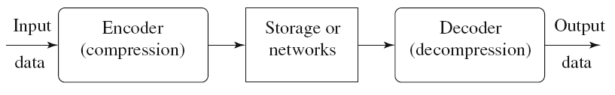
General data compression scheme
Compression is performed by an encoder
Decompression is performed by a decoder
If the compression and decompression processes induce no information loss, the compression scheme is lossless; otherwise, it is lossy
B C Dhara, Dept. of IT, JU

Slide 8

Performance analysis
If the total number of bits required to represent the data before compression is B₀
the total number of bits required to represent the data after compression is B₁
We define the compression ratio as,
We desire to have a compression ratio much larger than 1.0
B C Dhara, Dept. of IT, JU

Slide 9
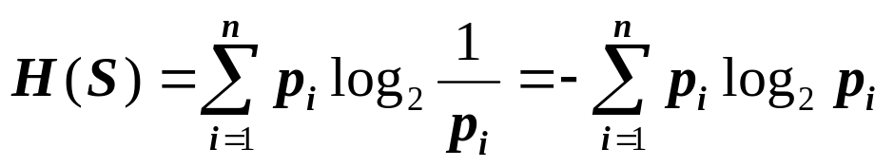
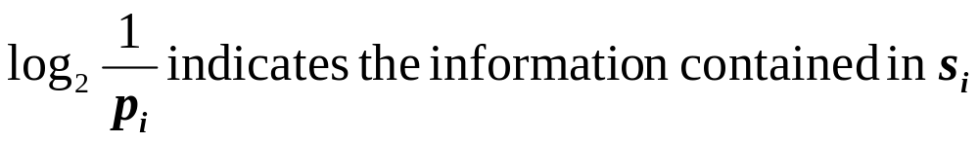
Information theory
According to the famous scientist Shannon, entropy H of an information source with alphabet S = {s₁, s₂, . . . , s_{n}} is defined as
where p_{i} is the probability of occurrence of s_{i} in S
which corresponds to the number of bits required to encode
B C Dhara, Dept. of IT, JU

Slide 10
Entropy
entropy is a measure of the disorder/uncertainty of a system
  the more the entropy, the more the disorder
entropy is aimed at identifying often-occurring symbols in the data stream as good candidates for short codewords in the compressed bitstream
  Variable length coding scheme for entropy coding
infrequently occurring ones are given longer codes
B C Dhara, Dept. of IT, JU

Slide 11
A symbol occurs infrequently, say, 1/1000
  Its self-information is log₂ 1000, a large value ➔ if the symbol occurs, a lot information ➔ need more bits
In computation of entropy,
  If a symbol occurs ‘zero’ times → ignore this symbol from (as cannot take a log of zero)
It is weighted sum of log₂ p_{i}
it represents the average amount of information contained per symbol in the source S.
B C Dhara, Dept. of IT, JU

Slide 12
the entropy α represents the minimum average number of bits required to represent each symbol in S.
Entropy ≤ average length of codewords
When all symbols of S are equal-probable
  Entropy is maximum and in that case no compression is possible.
the entropy is greater when the probability distribution is flat and smaller when it is more peaked
B C Dhara, Dept. of IT, JU

Slide 13
Run Length Coding
Run repetition of a symbol
Run length number of repeated symbols
Instead of encoding all the symbols individually, it is more efficient to encode the run-length and value of these run.
5 5 5 5 5 6 6 6 7 7 7 7 7 5 5 5 5
3 3 3 2 2 2 2 2 2 2 2 2 2 2 2 1 1 2
(3, 3), (12, 2), (2, 1), (1, 2), (0, x)
{(# of occurrences, value)}
(5, 5), (3, 6), (5, 7), (4, 5)
Suppose for counter 3 bits used
(3, 3), (7, 2), (5, 2), (1, 2), (0, x)

Slide 14
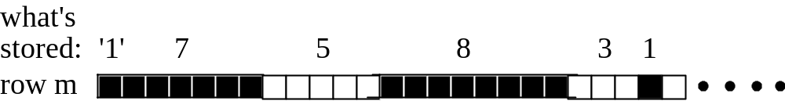
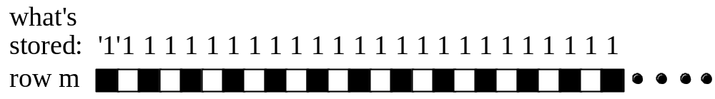
Run Length Coding
In case of binary string:
{# of occurrences} // assume first one is ‘1’
1 1 1 0 0 1 0 1 0
3, 2, 1, 1, 1, 1, 0
Run length Coding Example
When Does it Work?
  Images containing many runs of 1’s and 0’s
When Does it Not Work?
0 0 1 1 1 0 0 1 0 1 0
0, 2, 3, 2, 1, 1, 1, 1, 0

Slide 15
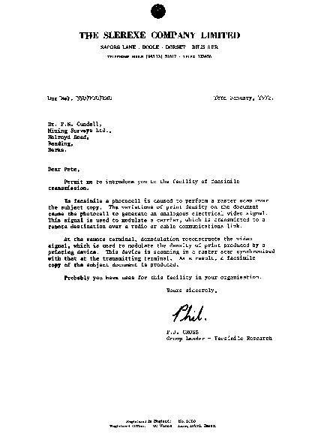
Run Length Coding
original: 513216 bytes
compressed: 37588 bytes
CR = 13.65

Slide 16
Variable-Length Coding
Shannon–Fano Algorithm
A string (or message) be given
  For each symbol compute the frequency of occurrences
  Arrange the symbols according to their frequencies
  Recursively divide the symbols into two parts, each with approximately the same number of counts, until all parts contain only one symbol.
  Every partition creates two children of the current node
A natural way of implementing the above procedure is to build a binary tree.
assign bit 0 to its left branches and 1 to the right branches

Slide 17
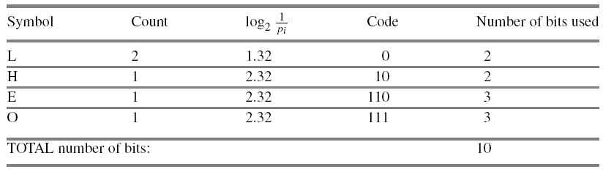

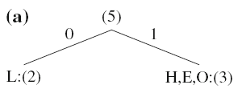
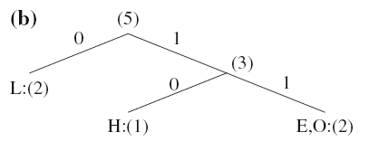

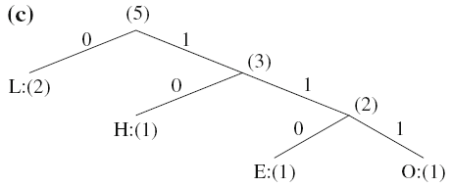
Shannon–Fano Algorithm (contd …)
Message: HELLO
Average bit requirement per symbol is at least 1.92
Table shows it is 10/5 =2
B C Dhara, Dept. of IT, JU

Slide 18
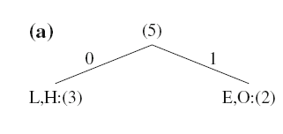
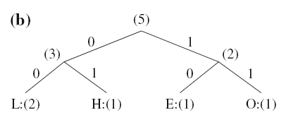
Shannon–Fano Algorithm (contd …)
The outcome of the Shannon–Fano algorithm is not necessarily unique.
B C Dhara, Dept. of IT, JU

Slide 19
Huffman coding
Shannon–Fano is a top-down approach
In Shannon-Fano,
  The symbols with lower frequencies appear at higher levels of the tree
Huffman coding is a bottom-up approach
  Start with two least frequent symbols
    Merge them and update their frequecy
B C Dhara, Dept. of IT, JU

Slide 20
Huffman Coding (contd ...)
Two-step algorithm:
  Iterate:
    Merge the least probable symbols.
    Sort.
  Assign bits.
0
0
0
a
0.5
0.5
0.5
Merge
10
10
1
b
0.25
0.25
0.5
Sort
110
11
c
0.125
0.25
Assign
111
Get code
d
0.125

Slide 21
Huffman Coding (contd ...)
Two-step algorithm:
  Iterate:
    Merge the least probable symbols.
    Sort.
  Assign bits.
0
0
0
a
0.5
0.5
0.5
Merge
10
10
1
b
0.25
0.25
0.5
Sort
110
11
c
0.125
0.25
Assign
111
Get code
d
0.125

Slide 22
Huffman Coding (contd ...)
The Huffman algorithm can be described in five steps:
Find the probability of the symbols
Order the input symbols according to their probabilities from smallest to largest
Combine the smallest two by addition
GOTO step 2, until only one is left
By working backward along the tree, generate code by alternating assignment of 0 and 1

Slide 23
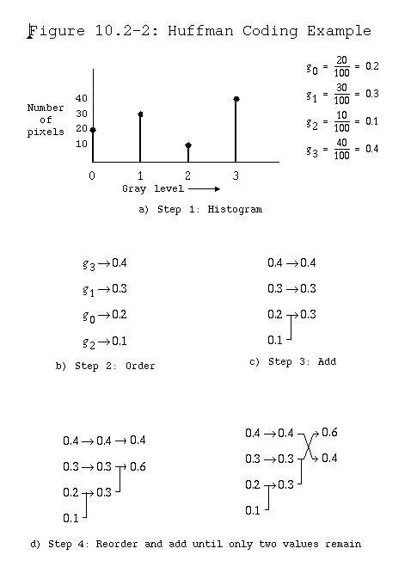
Huffman Coding (contd ...)

Slide 24
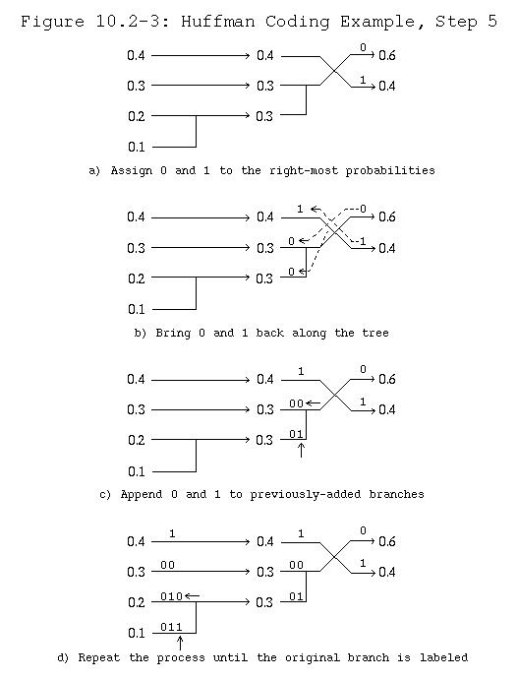
Huffman Coding (contd ...)

Slide 25
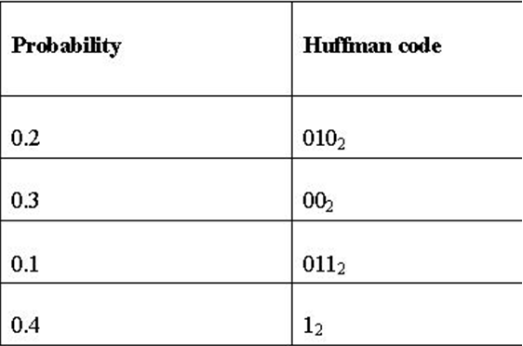
Huffman Coding (contd ...)
The two least frequent symbols will have the same length for their Huffman
Codes
Differing only at the last bit.
No Huffman code is a prefix of any other Huffman code
The Huffman code is one of the prefix codes for which the unique prefix property holds
Symbols that occur more frequently will have shorter Huffman codes than symbols that occur less frequently.

Slide 26
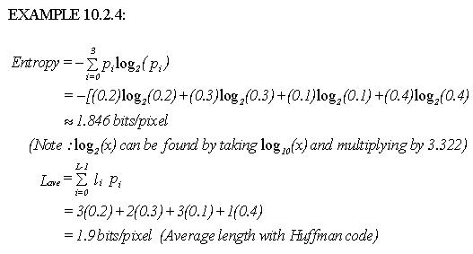
1.846 bits/symbol
1.9 bits/symbol
The average code length for an information source S
H(S) ≤ average bit requirement per symbol < H(S)+1

Slide 27
Huffman Coding: Pros and Cons
+ Fast implementations.
The code tree grows exponentially when the source is extended.
The symbol probabilities are built-in in the code.
Hard to use Huffman coding for extended sources / large alphabets or when the symbol probabilities are varying by time.

Slide 28
Extended Huffman coding
Huffman coding assigns each symbol a codeword that has an integer bit length
Bit requirement per symbol cannot be reduced to less than 1
  One way to address the problem of integral codeword length is to group several symbols and assign a single codeword to the group
  Extended Huffman Coding
B C Dhara, Dept. of IT, JU

Slide 29
Extended Huffman coding (contd ...)
Trick: Code blocks of symbols (extended source).
Example: p₁ = ¼ , p₂ = ¾.
Applying the Huffman algorithm directly:
1 bit/symbol.
Huffman coding: 1 bit/symbol
Block | P(block) | Code
00 | 9/16 | 0
01 | 3/16 | 10 | approx 0.843
10 | 3/16 | 110 | bits/symbol
11 | 1/16 | 111

Slide 30
Extended Huffman coding (contd ...)
If S={s₁, s₂, ..., s_{n}}, and k symbols are grouped then extended alphabet set S^{(k)} has n^{k} symbols.
If k is large and n ≥ 3
  n^{k} is very large, Extended Huffman Coding is impractical
The average code length for S(k)
H(S^{(k)}) ≤ average bit requirement per symbol < H(S^{(k)})+1/k

Slide 31
Adaptive Huffman Coding
Huffman algorithm requires prior statistical knowledge about the information source
  Which may not be always available
Even if it is available, it is a huge overhead to transmit this to the receiver end
We consider order-0 model
  For a symbol/character we do not consider context (history)
B C Dhara, Dept. of IT, JU

Slide 32
Adaptive Huffman Coding (contd ...)
One possible way to include contextual information is to examine k preceding symbols
  This is known as order k model
  The drawbacks are: store and sent much more symbols for order-k, when k>1
One possible solution
  Adaptive compression algorithms
B C Dhara, Dept. of IT, JU

Slide 33
Adaptive Huffman Coding (contd ...)
In which statistics are gathered and updated dynamically as the datastream arrives
The probabilities are no longer based on prior knowledge
The new coding methods are “adaptive”
  The probability distribution of the received symbols changes and symbols will be given new (longer or shorter) codes but on the actual data received so far
B C Dhara, Dept. of IT, JU

Slide 34
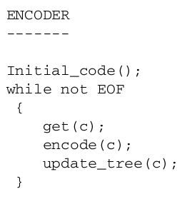
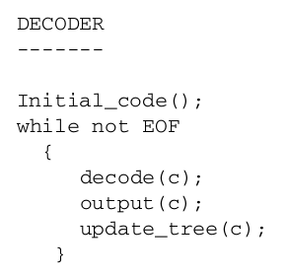
Adaptive Huffman Coding (contd ...)
B C Dhara, Dept. of IT, JU

Slide 35
Adaptive Huffman Coding: UPDATE TREE
MESSAGE : a a r d v a r k
At the very beginning, we have NYT node (Not Yet Transmitted)
and its counter (value) is 0
This node will remain in the entire process
and always in the left sub-tree
NYT
0
Initially, counter of all symbols is ‘0’
This is external node
As long we are getting symbols,
corresponding counter will be increased by 1
At the very begging tree is
NYT
0
B C Dhara, Dept. of IT, JU

Slide 36
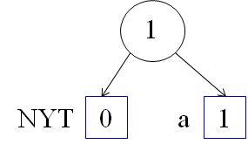


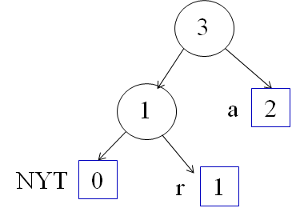
MESSAGE : a a r d v a r k
a
a
r
Check whether count value of left is less or equal to right or not
if yes, no change
if not, swap the nodes
If settled, then update weights
B C Dhara, Dept. of IT, JU

Slide 37
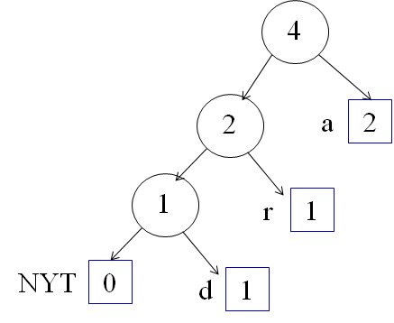
MESSAGE : a a r d v a r k
d
Check whether count value of left is less or equal to right or not
if yes, no change
if not, swap the nodes
If settled, then update weights
B C Dhara, Dept. of IT, JU

Slide 38
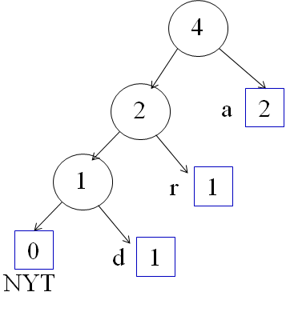
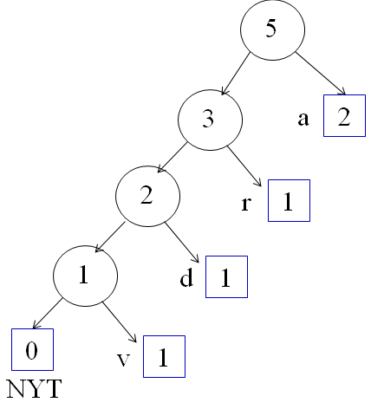
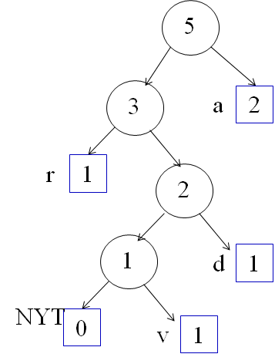
MESSAGE : a a r d v a r k
v
B C Dhara, Dept. of IT, JU

Slide 39
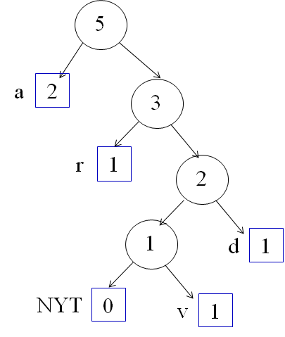
B C Dhara, Dept. of IT, JU

Slide 40

MESSAGE : a a r d v a r k
a
B C Dhara, Dept. of IT, JU

Slide 41

MESSAGE : a a r d v a r k
r
B C Dhara, Dept. of IT, JU

Slide 42
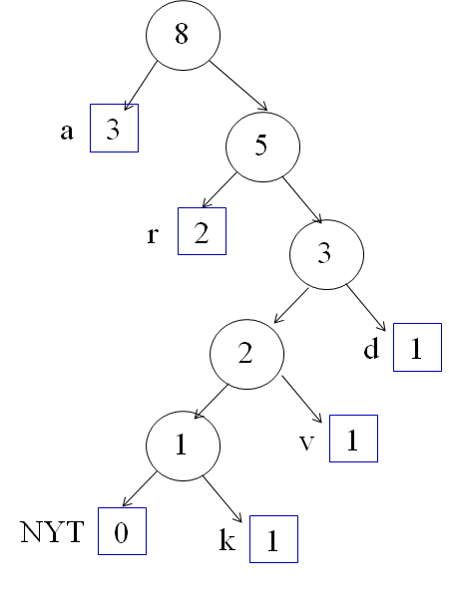
MESSAGE : a a r d v a r k
k
B C Dhara, Dept. of IT, JU

Slide 43
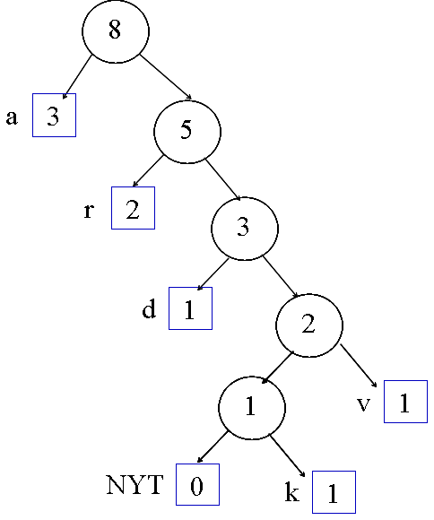
NO MORE SYMBOL ➔ stop
B C Dhara, Dept. of IT, JU

Slide 44
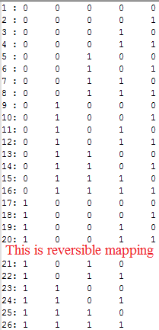
Adaptive Huffman coding: Encoding
Read input symbol
Code of a symbol: concatenation of the edge labels from root to that node
Fixed code: m = 2e + r, 0 ≤ r < 2e
  m is the number of symbols, in English it is 26
  26 = 2⁴ + 10 ➔ e=4 and r=10
  For any i, 1 ≤ i ≤ 26,
    If 1 ≤ i ≤ 2*r ➔ (e+1) bits to represent the binary equivalent of (i-1)
    If i > 2*r ➔ e bits to represent the binary equivalent of i-1-r
e-bit value 0 to 9, i.e, < r
r
r+1
r+2
2e-1
B C Dhara, Dept. of IT, JU

Slide 45
Read input symbol
  If this symbol appears first time
      Write the code of NYT followed by the fixed code of the current symbol
  Else send the code for the current symbol
Update the tree
B C Dhara, Dept. of IT, JU

Slide 46
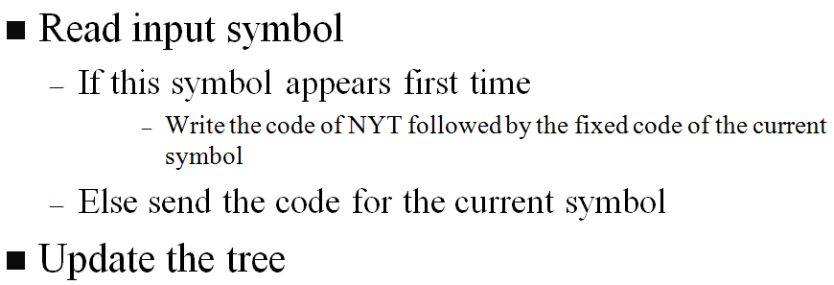
MESSAGE : a a r d v a r k
a a r d v a r k
φ # 00000
1
First appear
NYT code # fixed code of a
1
Code of current symbol ‘a’
2
0
1
1
0
NYT
0
a
1
NYT
0
a
2
B C Dhara, Dept. of IT, JU

Slide 47
MESSAGE : a a r d v a r k
a a r d v a r k
0 # 10001
2
3
1
0
0
1
NYT
0
a
2
1
a
2
0
1
First appear
NYT code # fixed code of r
NYT
0
r
1
B C Dhara, Dept. of IT, JU

Slide 48
MESSAGE : a a r d v a r k
a a r d v a r k
00 # 00011
3
4
0
1
0
1
1
a
2
2
a
2
0
0
1
1
NYT
0
r
1
1
r
1
0
1
First appear
NYT code # fixed code of d
NYT
0
d
1
B C Dhara, Dept. of IT, JU

Slide 49
Adaptive Huffman coding: Encoding (contd ...)
a a r d v a r k
φ # 00000
First appearance
1
0 # 10001
00 # 00011
Second case
000 # 1011
0
10
1100# 01010
Encoding string: 00000 1 010001 0000011 0001011 0 10 110001010
B C Dhara, Dept. of IT, JU

Slide 50
Adaptive Huffman coding: Decoding
0
1
1
e-bit value 0 to 9, i.e, < r
0
0
1
0
1
r
r+1
r+2
2e-1
0
1
B C Dhara, Dept. of IT, JU

Slide 51
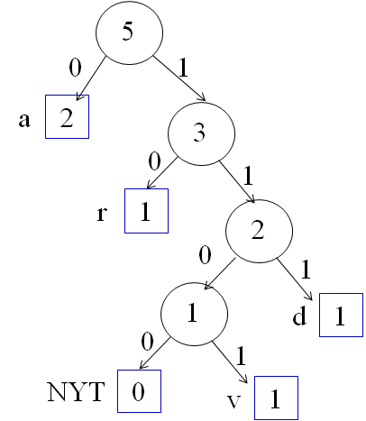
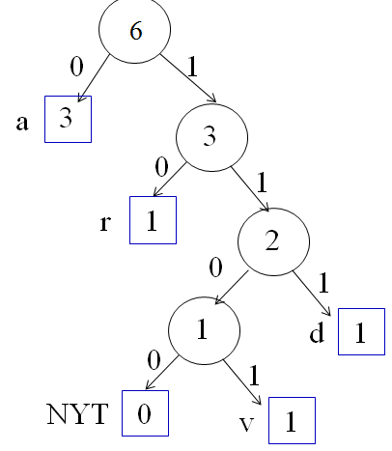
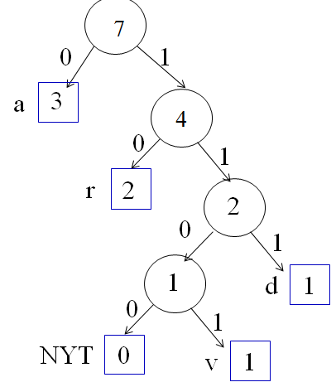
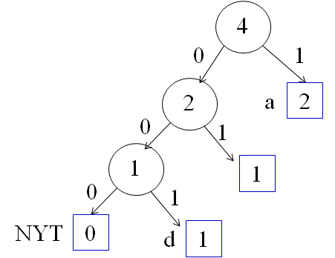
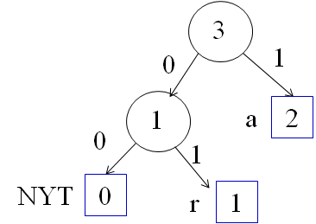
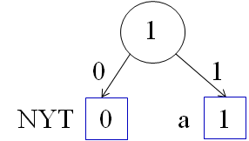
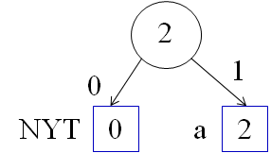

Adaptive Huffman coding: Decoding
Initial tree is NYT
00000 1 010001 0000011 0001011 0 10 110001010
While (there is input string)
start from root continue the reading of bits until reach to leaf node
If the current node is NYT
aardvar
aardvark
a
aa
aar
aard
aardv
aardva
Read first e bits
Its decimal value is p
Current node is NYT
Read 4 bits
p= 0 < 10
Read one more bit
p = 0
p=p+1=1
Current symbol ‘a’
Update tree
Current node non NYT node (‘a’)
Update the tree with current symbol ‘a’
Current node is NYT
Read 4 bits
p= 8 < 10
Read one more bit
p = 17
p=p+1=18
Current symbol ‘r’
Update tree
Current node is NYT
Read 4 bits
p= 1 < 10
Read one more bit
p = 3
p=p+1=1
Current symbol ‘d’
Update tree
Current node is NYT
Read 4 bits
p= 11 < 10 ?
P = p+r = 11+10 =21
p=p+1=22
Current symbol ‘v’
Update tree
Current node non NYT node (‘r’)
Update the tree with current symbol ‘r’
Current node is NYT
Read 4 bits
p= 5 < 10 ?
p = 2*p+0 = 10
p=p+1=11
Current symbol ‘k’
Update tree
Current node non NYT node (‘a’)
Update the tree with current symbol ‘a’
If p < r
Read one more bit
p = 2*p + bit value
else p = p + r
p = p+ 1
Decode the symbol using p
Update tree with symbol representing by p
If current node is not NYT output this symbol
update the tree with the current symbol
B C Dhara, Dept. of IT, JU

Slide 52
Arithmetic coding
Arithmetic coding usually outperforms Huffman coding
Arithmetic coding has different versions:
  Fast Binary Arithmetic Coding used in JBIG, JBIG2 and JPEG-2000
  Context-Adaptive Binary Arithmetic Coding (CABAC) used in H.264 and H.265
Huffman coding assigns each symbol a codeword that has an integral bit length.
which corresponds to the number of bits required to encode
B C Dhara, Dept. of IT, JU

Slide 53
Arithmetic coding (contd ...)
Arithmetic coding treats the whole message as one unit and achieve fractional number of bits for each input symbol
  In practice, the input data is usually broken up into chunks to avoid error propagation
  We present a simplistic approach and include a terminator symbol
B C Dhara, Dept. of IT, JU

Slide 54
Basic Arithmetic Coding Algorithm
In arithmetic coding, a message is represented by a half-open interval [a, b) where a and b are real numbers between 0 and 1
  Initially, the interval is [0, 1)
  Longer the message, the length of the interval shortens, and the number of bits needed to represent the interval increases
Arithmetic coding uses the probability distribution of the data, so it can theoretically achieve the maximum compression specified by the entropy
B C Dhara, Dept. of IT, JU

Slide 55
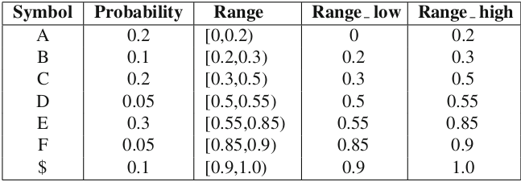
Suppose we have A, B, C, D , E , F and $ with probability 0.2, 0.1, 0.2, 0.05, 0.3, 0.05, 0.1
Consider these on 0-1 line serially as cumulative
B C Dhara, Dept. of IT, JU

Slide 56
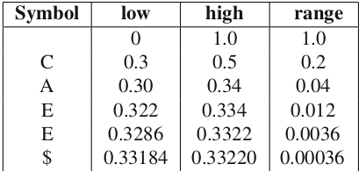
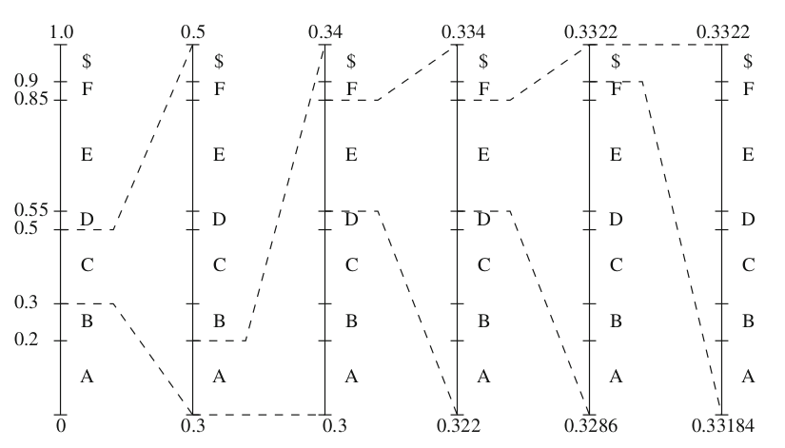
Message CAEE$
0.2*0.2 = 0.04
0.04*0.85 = 0.034
0.012*0.85 = 0.034
low = low + range * Range_low(symbol)
high = low + range * Range_high(symbol)
range=high-low
0.04*0.55 = 0.022
B C Dhara, Dept. of IT, JU

Slide 57
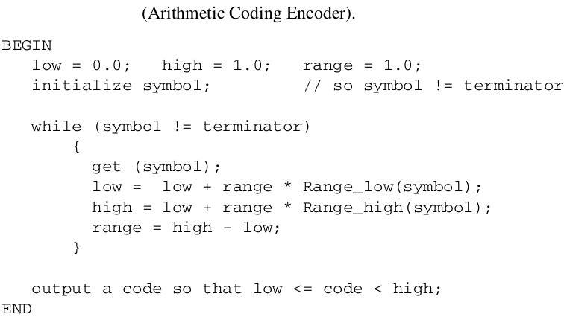
B C Dhara, Dept. of IT, JU

Slide 58
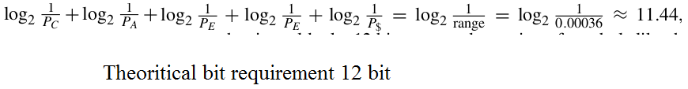

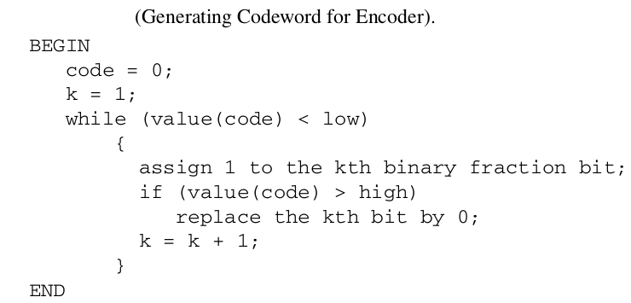
How to generate the binary code?
r =
low = 0.33184, high=0.3322
Initially it is true
Assign 1 (k=5), dec(0.01011) =0.3437> high code[5]=0, dec(0.01010) =0.3125< low loop continue
// decimal value
In the worst case, the shortest codeword in arithmetic coding will require r bits to encode a sequence of symbols,
Assign 1 (k=8), dec(0.01010101) = 0.33203125 < low false, stop
Bit requirement is 8
0.01010101
Assign 1 (k=1), dec(0.1) =0.5> high code[1]=0, dec(0.0) =0< low loop continue
Assign 1 (k=2), dec(0.01) =0.25> high code[2]=1, dec(0.01) =0.25< low loop continue
as
Assign 1 (k=3), dec(0.011) =0.37> high code[3]=0, dec(0.010) =0.25< low loop continue
Assign 1 (k=4), dec(0.0101) =0.3125> high code[3]=1, dec(0.0101) =0.3125< low loop continue
B C Dhara, Dept. of IT, JU

Slide 59
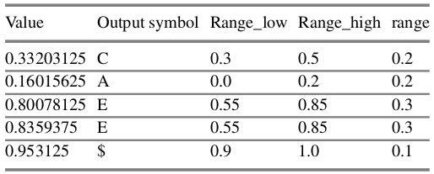
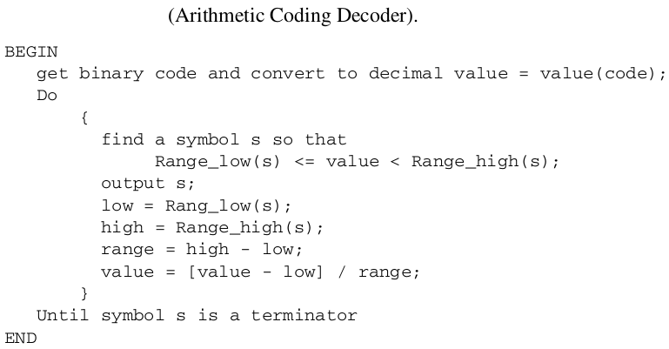
Arithmetic decoder
B C Dhara, Dept. of IT, JU

Slide 60
Arithmetic coding achieves better performance than Huffman coding,
  AC treats an entire sequence of symbols as one unit, whereas the HC has the restriction of assigning an integral number of bits to each symbol
  For example, HC requires 12 bits for CAEE$, the worst-case performance of arithmetic coding
B C Dhara, Dept. of IT, JU

Slide 61
Limitations of arithmetic coding
When it is used to code long sequences of symbols, the tag intervals shrink to a very small range
  Representing these small intervals requires very high-precision numbers (i.e., even 32-bit or 64-bit floating-point may not be enough) as more than a few symbols are coded
The encoder will not produce any output codeword until the entire sequence is entered
The decoder needs to have the codeword for the entire sequence of the input symbols before decoding
B C Dhara, Dept. of IT, JU

Slide 62
Limitations of arithmetic coding
Scaling and Incremental coding of the arithmetic coding can be used to solve this
The similar approach can be used in integer implementation of the arithmetic coding
B C Dhara, Dept. of IT, JU

Slide 63
LZW coding
The Lempel-Ziv-Welch (LZW) algorithm employs an adaptive, dictionary-based compression technique.
LZW uses fixed-length codewords to represent variablelength strings of symbols/characters that commonly occur together
The encoder and the decoder both develop the same dictionary
The predecessors of LZW are LZ77 and LZ78
B C Dhara, Dept. of IT, JU

Slide 64
LZW stores longer and longer repeated entries into a dictionary
Then emitting the code for an element rather than the string itself, if the element has already been placed in the dictionary.
B C Dhara, Dept. of IT, JU

Slide 65
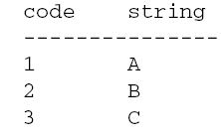
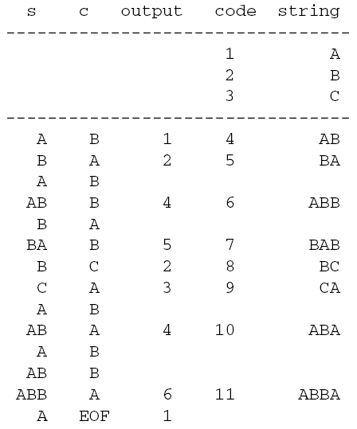
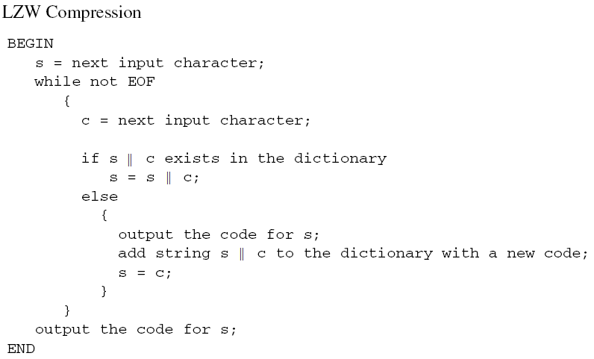
LZW coding
ABABBABCABABBA
For each symbol, size is 1 byte ➔
Compression ration = 14/9 = 1.56
B C Dhara, Dept. of IT, JU

Slide 66
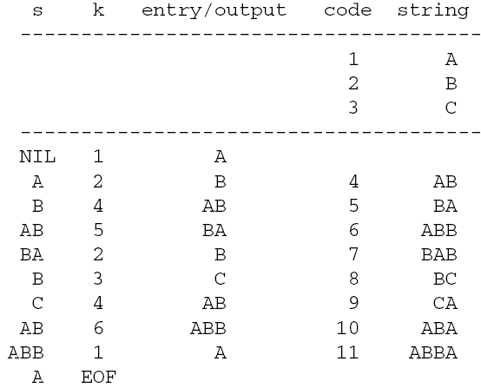
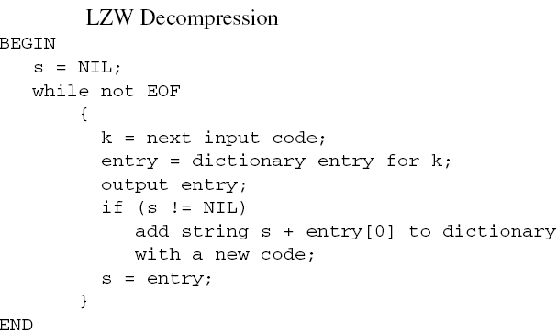
1 2 4 5 2 3 4 6 1
ABABBABCABABBA
B C Dhara, Dept. of IT, JU

Slide 67
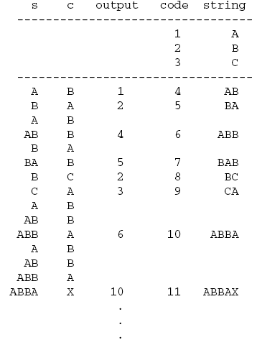

“???” indicates that the decoder has encountered a difficulty:
no dictionary entry for the input code, 10
ABABBABCABBABBAX....
1 2 4 5 2 3 6 10 ...
B C Dhara, Dept. of IT, JU

Slide 68

B C Dhara, Dept. of IT, JU

Slide 69

Pulse code modulation
PCM is a method of digital transmission of an analog signal
In PCM an analog signal or information is converted into a binary sequence, i.e.,’ 1’s and ‘0’s
  The output of a PCM resembles a binary sequence
Sampling &
Quantization
B C Dhara, Dept. of IT, JU

Slide 70


A/D converter
Basic block diagram of an A/D converter
B C Dhara, Dept. of IT, JU

Slide 71

Types of modulations
B C Dhara, Dept. of IT, JU

Slide 72

Elements of a PCM System
Transmitter
Transmission path
Receiver
Transmission path
B C Dhara, Dept. of IT, JU

Slide 73

Transmitter of PCM
Low pass filter: This filter eliminates the high frequency components present in the input analog signal which is greater than the highest frequency of the message signal, to avoid aliasing of the message signal
B C Dhara, Dept. of IT, JU

Slide 74
Transmitter of PCM (contd …)
Sampler: This is the technique which helps to collect the sample data at instantaneous values of message signal, so as to reconstruct the original signal
  The sampling rate must be greater than twice the highest frequency component W of the message signal, in accordance with the sampling theorem
B C Dhara, Dept. of IT, JU

Slide 75

Example of sampling
B C Dhara, Dept. of IT, JU

Slide 76
Transmitter of PCM (contd …)
Quantizer: Quantizing is a process of reducing the excessive bits and confining the data
  The sampled output when given to quantizer reduces the redundant bits and compresses the value
Encoder: Encoder assigns code words to quantized sampled values. This coding techniques uses bits 0 and 1
  For example, if number of quantized levels are 16 then each sample is assigned with 4 bit code word
B C Dhara, Dept. of IT, JU

Slide 77

Quantization & encoding
B C Dhara, Dept. of IT, JU

Slide 78


Types of uniform quantization
Two types:
Mid-Rise type
Mid-Tread type
The Mid-Rise type is so called because the origin lies in the middle of a raising part of the stair- case like graph
The Mid-tread type is so called because the origin lies in the middle of a tread of the stair-case like graph
B C Dhara, Dept. of IT, JU

Slide 79
Signaling rate and number of quantization levels
If ‘v’ is the number of bits used to represent each quantization level
  Number of quantization levels = 2^{v}
Number of bits per second is called signaling rate
  v.f_{s} , f_{s} is the sampling rate (or, sampling frequency)
If the number of binary bits = 3 and the sampling rate is 2 sample/sec find the signaling rate, number of quantization levels?
Number of quantization levels = 8
Signaling rate = 3*2 = 6 bits/sec
B C Dhara, Dept. of IT, JU

Slide 80

Sampling and quantization
B C Dhara, Dept. of IT, JU

Slide 81



Sampling and quantization
B C Dhara, Dept. of IT, JU

Slide 82

Lossless Predictive coding
Predictive coding simply means transmitting differences
Predict the current value from some previous values and then the error due to this prediction will be transmitted
  Current value is predicted as the previous value
  Error = s_{c} – s_{p}
  If value ∈ [0, 255] ➔ error ∈ [-255, 255] just double the range
B C Dhara, Dept. of IT, JU

Slide 83




Lossless Predictive coding (contd ...)
Goode prediction reduces the range of differences
B C Dhara, Dept. of IT, JU

Slide 84


Lossless Predictive coding (contd ...)
B C Dhara, Dept. of IT, JU

Slide 85

DPCM coding
Differential Pulse Code Modulation is exactly the same as Predictive Coding,
  except that it incorporates a quantizer step.
B C Dhara, Dept. of IT, JU

Slide 86




DPCM coding (contd ...)
B C Dhara, Dept. of IT, JU

Slide 87







Example of DPCM coding
Org Sig | 130 | 152 | 141 | 150 | 100 | 100 | 140
Pred | 130 | 152 | 141 | 145 | 143 | 128 | 111
Err: | 0 | 0 | 0 | 5 | -43 | -28 | 29
Q- dQ (err) | 0 | 0 | 0 | 0 | -32 | -16 | 16
Rec Sig | 130 | 152 | 141 | 145 | 111 | 112 | 127
B C Dhara, Dept. of IT, JU

Slide 88

Predictive Coding
Intuitive Idea
  Image pixels are highly correlated (dependent)
  Predict the image pixels to be coded from those already coded
Differential Pulse-Code Modulation (DPCM)
  Simplest form: code the difference between pixels
  Key features: Invertible, and lower entropy (why?)
Original pixels:
82, 83, 86, 88, 56, 55, 56, 60, 58, 55, 50, ……
DPCM:
82, 1, 3, 2, -32, -1, 1, 4, -2, -3, -5, ……
From Prof. Al Bovik
image histogram (high entropy)
DPCM histogram (low entropy)

Slide 89






Predictive Coding
Higher Order (Pattern) Prediction
  Use both 1D and 2D patterns for prediction
1D Causal:
2D Causal:
1D Non-causal:
2D Non-Causal:

Slide 90
An Image Coding Application
Consider the image content in a local environment of a pixel as a state in a Markov model.
Example (binary image):
Such an environment is called a context.
A probability distribution for X can be estimated for each state. Then arithmetic coding is used.
This is the basic idea behind the JBIG algorithm for binary images and data.
0
0
1
1
0
X

Slide 91


Slide 92


Slide 93
1
MESSAGE : a a r d v a r k
51
NYT
0
a
NYT
0
a
1
51
49
50
2
a
51
3
NYT
0
a
2
r
51
49
50
1
a
2
Check whether count value of left is less or equal to right or not
if yes, no change
if not, swap the nodes
If settled, then update weights
50
49
NYT
0
r
1
47
48
B C Dhara, Dept. of IT, JU

Slide 94
MESSAGE : a a r d v a r k
4
3
51
51
d
2
a
2
1
a
2
50
49
50
1
49
r
1
NYT
0
r
1
47
48
47
48
NYT
0
d
1
Check whether count value of left is less or equal to right or not
if yes, no change
if not, swap the nodes
If settled, then update weights
45
46
B C Dhara, Dept. of IT, JU

Slide 95

4
MESSAGE : a a r d v a r k
51
2
a
2
v
50
49
1
r
1
5
47
48
45
51
0
d
1
NYT
46
3
a
2
50
49
r
1
2
47
48
1
d
1
45
46
NYT
0
v
1
43
B C Dhara, Dept. of IT, JU
44

Slide 96
5
51
5
3
a
2
51
50
49
a
2
r
1
3
2
49
47
50
48
r
1
1
2
d
1
47
45
46
48
NYT
1
d
1
0
v
1
43
44
45
46
NYT
0
v
1
43
44
B C Dhara, Dept. of IT, JU

Slide 97
MESSAGE : a a r d v a r k
5
6
51
51
a
2
a
a
3
3
3
49
49
50
50
r
1
r
1
2
2
47
47
48
48
1
d
1
1
d
1
45
46
45
46
NYT
0
v
1
NYT
0
v
1
43
44
43
44
B C Dhara, Dept. of IT, JU

Slide 98
MESSAGE : a a r d v a r k
6
r
7
51
51
a
3
a
3
3
4
49
49
50
50
r
1
r
2
2
2
47
47
48
48
1
d
1
1
d
1
46
45
46
45
NYT
0
NYT
0
v
1
v
1
43
44
43
44
B C Dhara, Dept. of IT, JU

Slide 99
MESSAGE : a a r d v a r k
8
k
7
51
a
3
5
a
3
4
49
50
r
2
3
r
2
2
47
48
2
d
1
1
d
1
45
46
1
v
1
NYT
0
v
1
43
44
NYT
0
k
1
B C Dhara, Dept. of IT, JU

